Slide 1
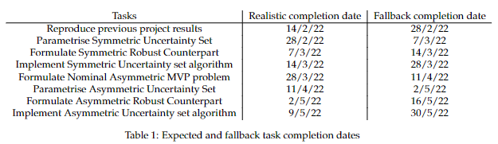

Slide 2
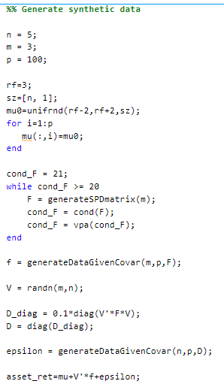
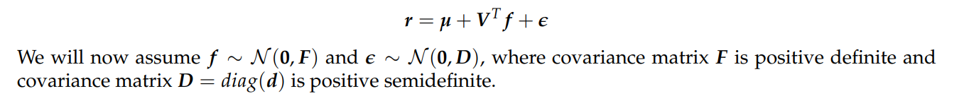
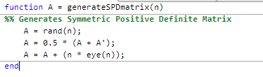
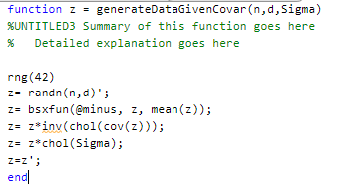
?
?

Slide 3
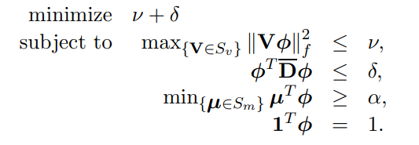

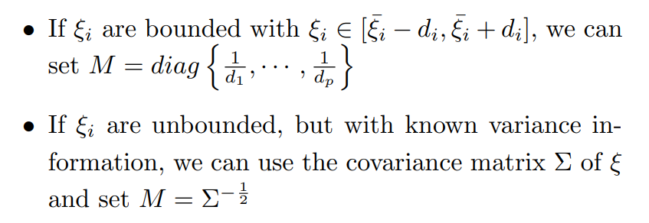

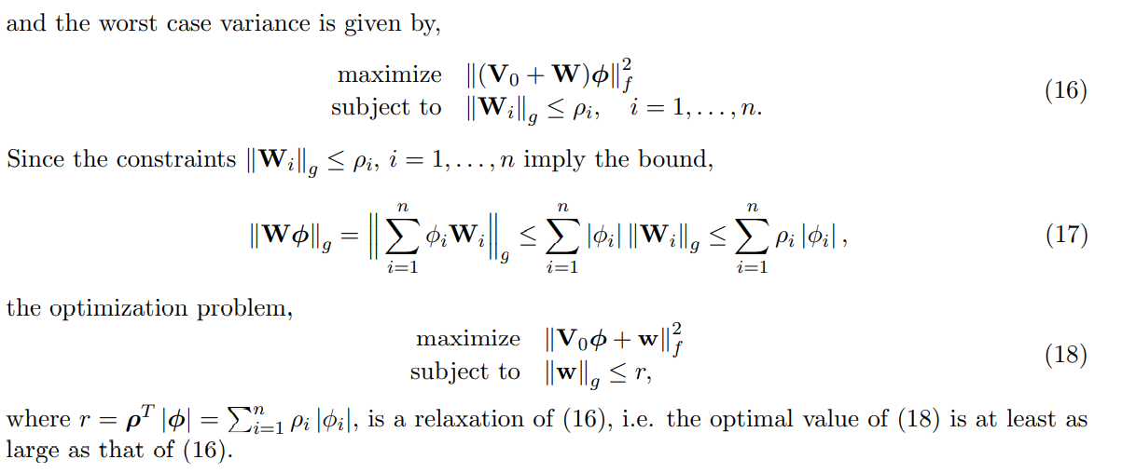
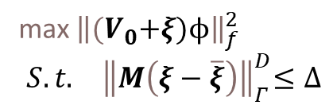

?
Worst case variance:
max ${\left\|{(V}_{0}+ξ)ϕ\right\|}_{f}^{2}$
$$S.t.{ \left\|M\left(ξ−\overline{ξ}\right)\right\|}_{Γ}^{D}≤Δ$$
$$S_{v}=\left\{V:V=V_{0}+ξ,{\left\|M\left(ξ−\overline{ξ}\right)\right\|}_{Γ}^{D}≤Δ\right\}$$
Next step

Slide 4
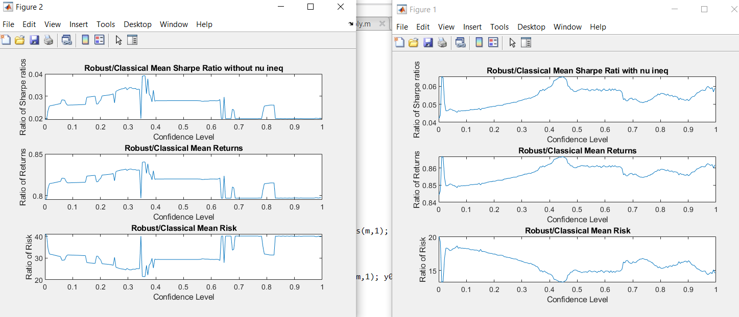
Some smoothing, still not great

